Slide 1
Every Child A Seed
Supported by
Notes:
Remove Capitaland logo

Slide 2
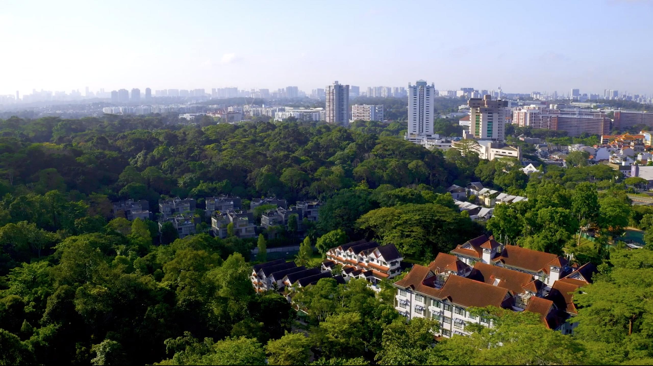
Singapore, our City in Nature
https://go.gov.sg/watchcityinnature
Notes:
https://go.gov.sg/watchcityinnature

Slide 3
Our Greening History
It all began on 16 June 1963 - Mr Lee Kuan Yew planted a tree in Farrer Circus, signifying the start of the tree planting campaign.
Fast-growing, shady trees were planted, flyovers and overhead bridges were covered with creeper plants, and green parks dotted the island.
NParks commemorated 50 years of Greening Singapore in 2013.

Slide 4
City in Nature – Importance of the Community
We have come a long way since we embarked on our greening journey more than 50 years ago
We have since evolved into a biophilic City in a Garden where greenery pervades our urban landscape.
Moving forward, with our new City in Nature vision, we aim to restore nature back into the city to make it more livable and sustainable, while remaining resilient to challenges that urbanization and climate change will bring.
Everyone has a part to play in transforming Singapore into a City in Nature. This includes people like yourself: educators and students!

Slide 5
What is Every Child A Seed?
Programme started in 2013 to enable students nationwide to commemorate 50 Years of Greening Singapore.
Aims to convey to students that every Singaporean plays a part in shaping our City in Nature.
Provides students with an opportunity to go through and appreciate the challenges of the planting process and experience the joy of seeing their plants grow.
Akin to the process of building our City in Nature– need dedication, commitment and involvement from the community.

Slide 6
What the programme entails
Every Primary 3 student will receive a plant starter kit.
Teachers are encouraged to carry out the suggested lessons found in the Teachers’ Resource Kit.
Teachers will teach students how to plant the seeds and record and track the growth of their plants in their plant journal.
Pupils are encouraged to send photographs of their full-grown plants and their reflection to the National Parks Board via email to enna_lam@nparks.gov.sg

Slide 7
What schools will receive
Plant Starter Kits for Primary 3 students:
✔A small pot
✔A packet of potting mix
✔A packet of seeds (containing Sunflower, Roselle or Sweet Basil)
✔A copy of My Plant Journal

Slide 8
Supporting resources
Every Child A Seed video available at https://www.youtube.com/watch?v=6x0IZfoz9yo
Teacher’s Resource Kit
Lesson 1 powerpoint slides
Lesson 2 powerpoint slides
Activity Worksheet 1 for Lesson 1
Activity Worksheet 2 for Lesson 1
Available online at https://www.nparks.gov.sg/everychildaseed

Slide 9
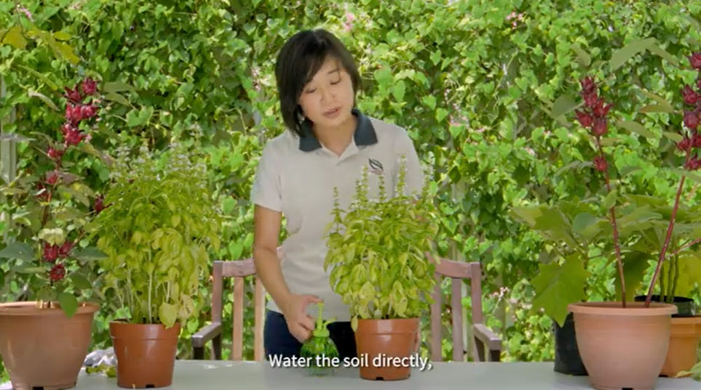
Supporting resources: Every Child A Seed videos
Part 2: Step-by-step Planting Guide
Part 3: Gardening Tips

Slide 10
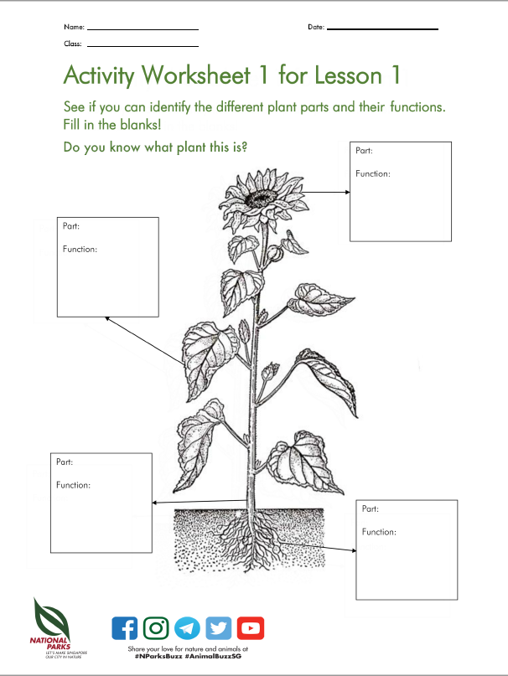
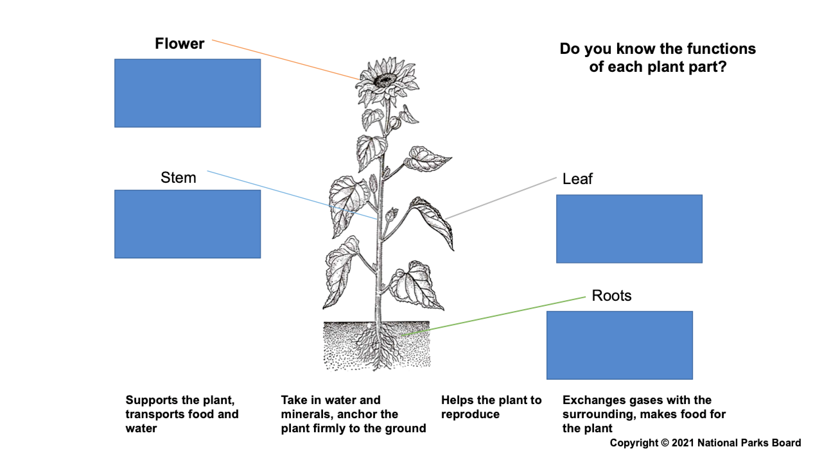
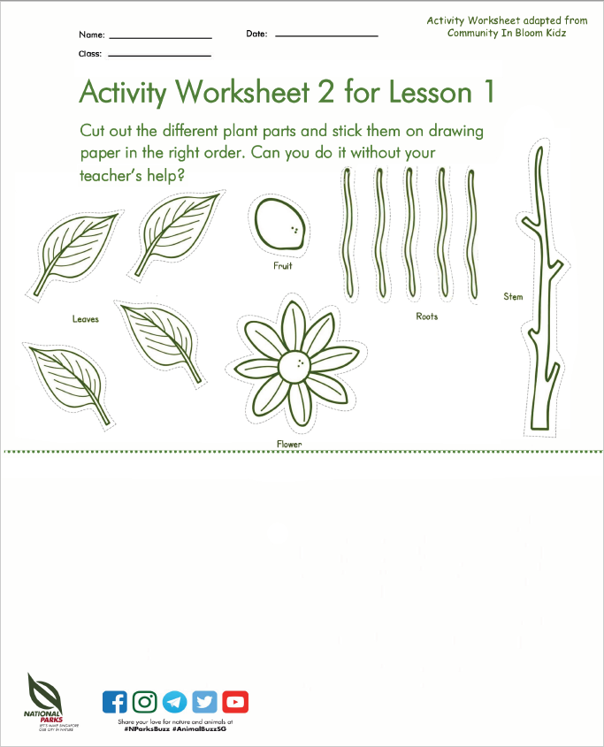
Supporting resources: Lesson Plan 1, Powerpoint Slides & Activity Sheets
Learning objectives:
Appreciate the importance of plants
Understand why plants are classified as living things
Identify the different parts and their functions

Slide 11
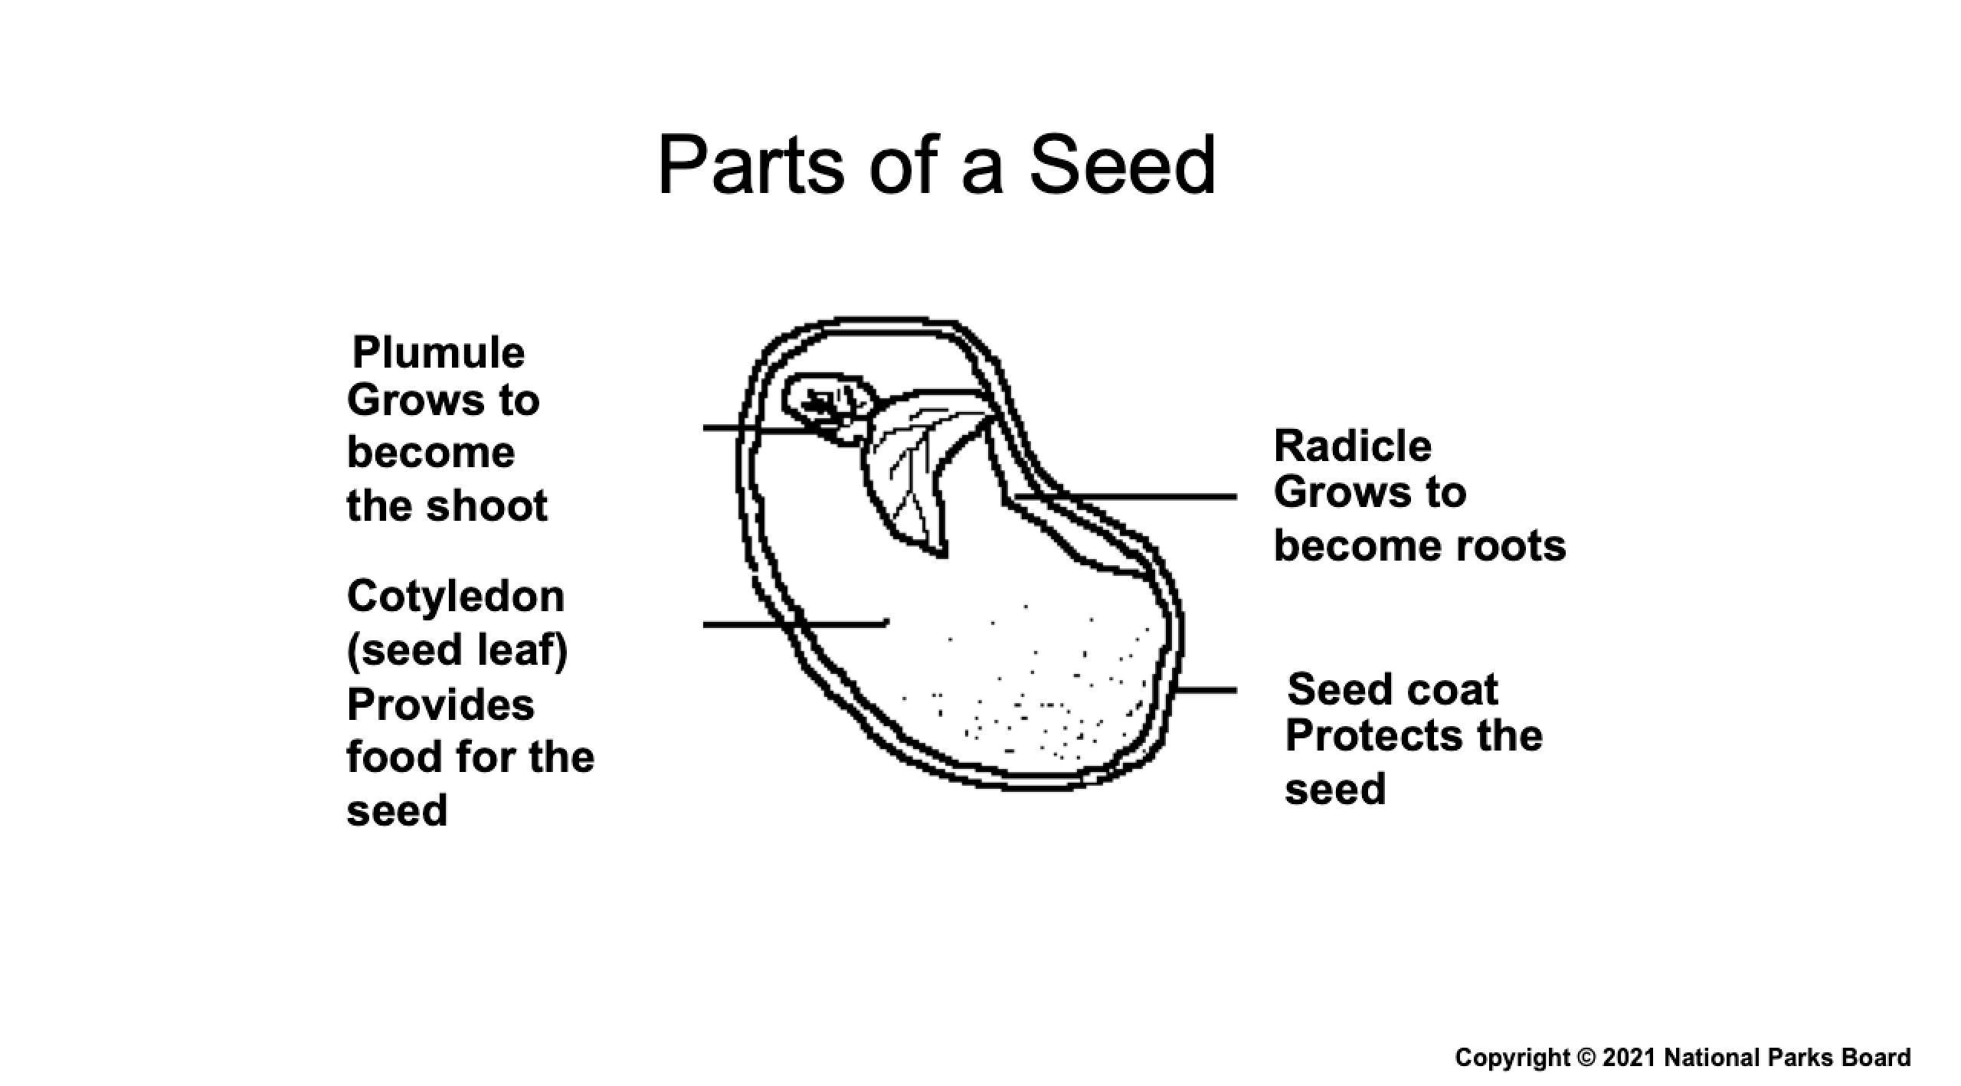
Supporting resources: Lesson Plan 2 & Powerpoint Slides
Learning objectives:
Be able to grow plants from seeds
Know the conditions necessary for germination to take place
Appreciate the challenges of the planting process
Understand that a City in Nature requires care and nurturing

Slide 12
Frequently Asked Questions
Q: How is Every Child a Seed relevant to what students learn in school?
A: The programme has been tailored to complement the Primary 3 Science Syllabus on Diversity. Students will learn about the life cycle of a plant, plant parts and their functions. The lessons will also teach them the values of care and responsibility.
Q: What is the cost of adopting the programme?
A: The programme is free. It is fully sponsored by the Garden City Fund, a registered charity established by NParks but managed independently.
Q: When will schools be receiving the plant starter kits?
A: Schools can expect to receive the kits from May onwards. As the courier company will be grouping the schools based on location, it is not possible for us to determine when exactly a particular school will be receiving the kits. We appreciate the understanding of all schools in this.

Slide 13
Frequently Asked Questions
Q: Can my school use the resources for other levels besides Primary 3?
A: While we encourage schools to use the kits for their Primary 3 cohort due to its relevance to P3 science, schools are free to re-distribute the starter kits to students in other levels. The number of starter kits delivered to schools however, is based on the Primary 3 cohort unless otherwise specified by the school.
Q: Where can I obtain additional planter kits?
A: Schools can write in to enna_lam@nparks.gov.sg and we will try to accommodate the request. Schools may also consider making their own purchases of planting pots, potting mix and seeds from nurseries.

Slide 14
Frequently Asked Questions
Q: Is there a deadline for schools to carry out the programme? My school is covering the topic on plants only in Term 3/4.
A: There is no deadline for schools to carry out the programme. However, for the seeds to have a better chance of successful germination, they should ideally be planted within 1-2 months upon receiving the planting kits. This is because prolonged storage may affect the rate of germination of the seeds.
Seeds should be kept under dark, dry, cool and air-tight conditions. Seal seeds in dark, air-tight bags and place in a cupboard, away from direct sunlight or in a refrigerator at 10˚C.
Consider planting the Roselle (Hibiscus sabdariffa) seeds within 1 - 2 weeks after receiving them as their rate of germination tends to decline rapidly with prolonged storage.

Slide 15
Frequently Asked Questions
Q: Can my school request for Sunflower/Sweet Basil/Roselle seeds only?
A: We will be allocating schools a mixture of all 3 seeds. The reason we are using 3 types of plants is to allow students to experience diversity in the plant kingdom. With the 3 types of plants, they can then make comparisons of the different conditions under which these plants grow well.
Q: How strictly do I have to follow the lesson plans?
A: The lesson plans are optional. While we encourage teachers to carry out both lessons, they are merely guides which teachers can adapt however they see fit.
Q: Who do I contact if I have any queries?
A: Teachers and pupils can visit our website, where more FAQs can be found. If the info on the website does not address your question, please write to enna_lam@nparks.gov.sg.

Slide 16
Useful Links
1. National Parks Board website
https://www.nparks.gov.sg
2. National Parks Learning portal
https://www.nparks.gov.sg/learning
3. Every Child a Seed webpage
https://www.nparks.gov.sg/everychildaseed
4. Flora&FaunaWeb
https://florafaunaweb.nparks.gov.sg/
5. National Parks YouTube channel
https://www.youtube.com/NParksSG

Slide 17
Thank you

